Slide 1

Pump Performance Monitoring
while-1-fork
Dhruv Arya | Jay Sharma | Nomaan Qureshi

Slide 2
Initial Objectives
Use the meters to measure energy consumption and flow of water.
Push the data onto a server.
Measure the efficiency in terms of energy consumption and flow.
Understand the different protocols used.

Slide 3
How we read sensor values
Read energy meter values using modBus protocol.
Read flow meter values with pulse-count increment on interrupt.
Read temperature and humidity sensor data using I2C protocol.

Slide 4
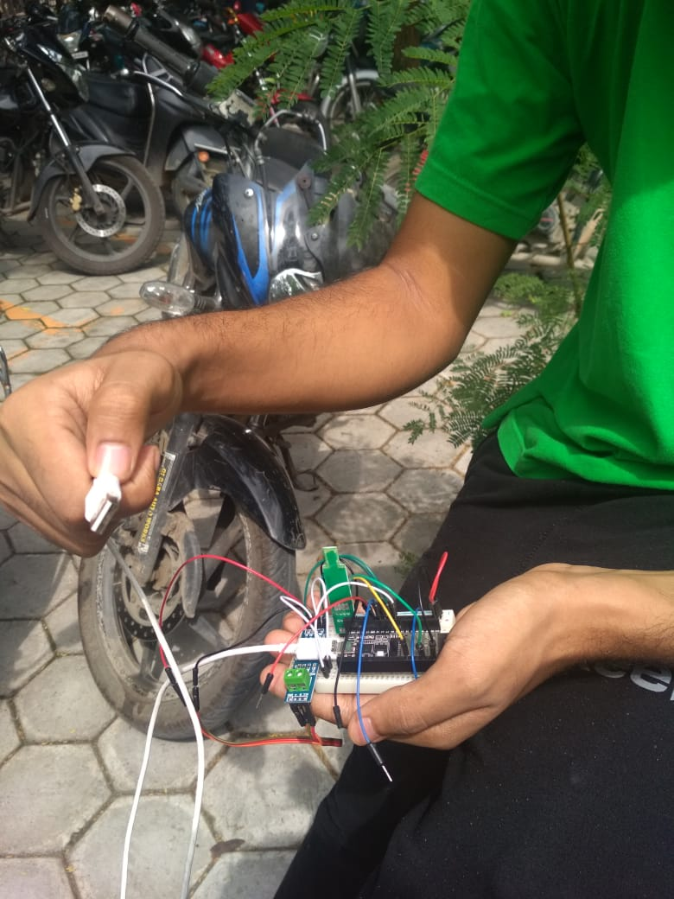
Testing the prototype
Using a breadboard, we connected the circuit to
the energy and flow meters. This is the first time
we got readings from all sensors together

Slide 5
How we pushed the data onto the server
OneM2M protocol was used for creation of application entities and nodes, with data containers for all different types of values pushed.
With correct AEs with descriptions, types and units, the data can be easily read and parsed by any developer who wishes to develop a frontend service for the same.

Slide 6
Deployment & Front-end development
PHYSICAL DEPLOYMENT:
The energy meter’s, flow meter’s, and temperature sensor’s connections made to the ESP32 board using a PCB attached firmly inside a casing containing a power bank as backup power source and a charging brick going into the bank.
FRONT-END DEVELOPMENT:
A python-flask app (supposed to be run on a server) with an SQLite database which essentially provides a monitor to view various statistics on data obtained on requesting the OneM2M server.

Slide 7
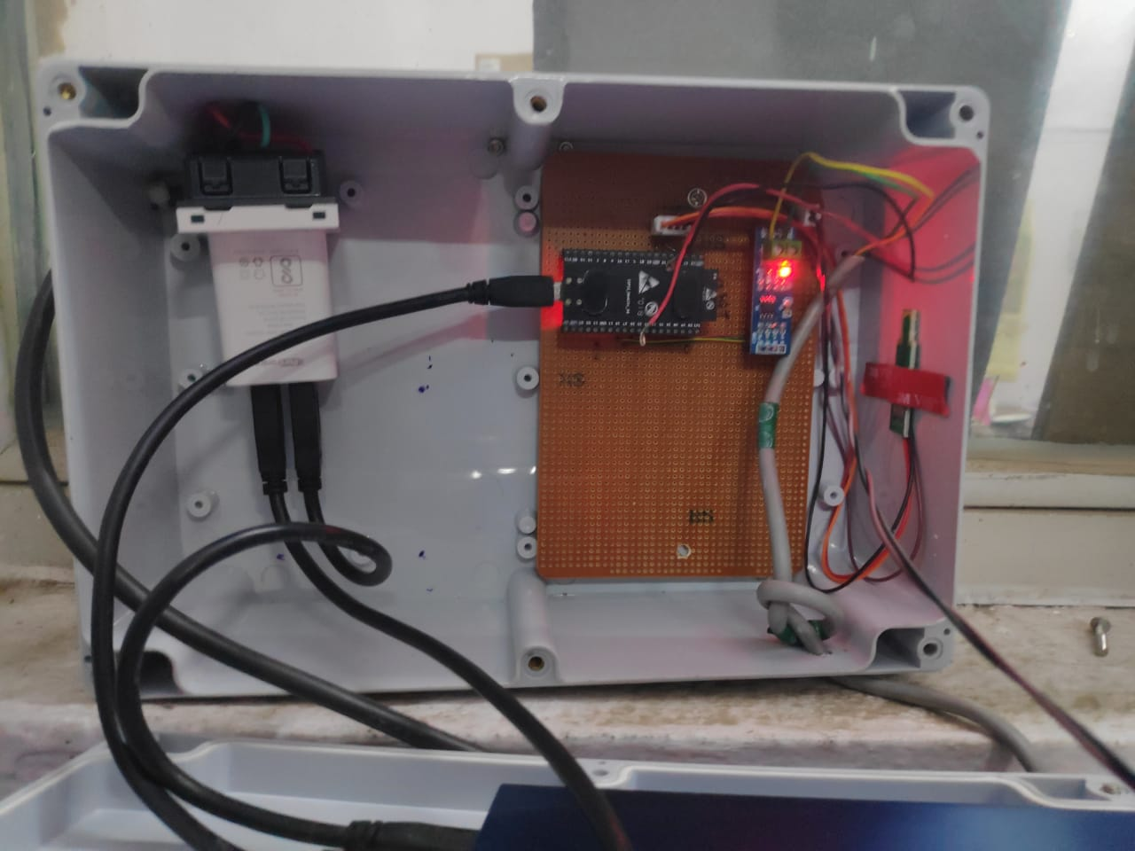
Final deployed box
The final box contains the following
components:
ESP32 board
Power Bank, cables, and charger
Level shifter
Temperature and RH sensor
PCB, wires, and connections to flow
meter and energy meter.

Slide 8
Front-end: A Detailed View
We used flask framework to build a web-app.
SQLite database is used to store the data locally on the server.
We used flask because it provides simplicity, flexibility and fine-grained control.
We used SQLite database because it emphasizes scalability, concurrency, centralization.
Plotly.js library is used to plot the datapoints. We plotted Graphs which include the graphs like Temperature VS Time, Humidity VS Time, Flow VS Time, Efficiency vs Time etc.
From the color of the status button, we can know the state of the system. Black means system is off. Green means attribute is working properly. Yellow means attribute is in a state near breakdown. Red means attribute is in a breakdown state.

Slide 9
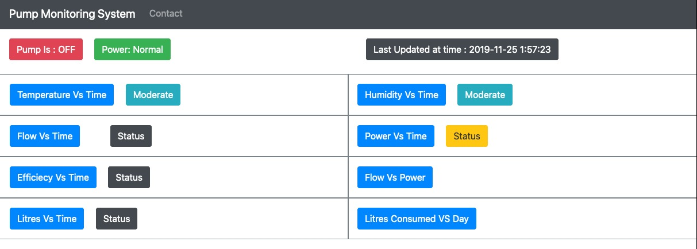
The dashboard

Slide 10
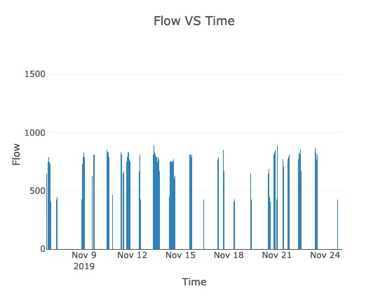
Results from the data we collected

Slide 11
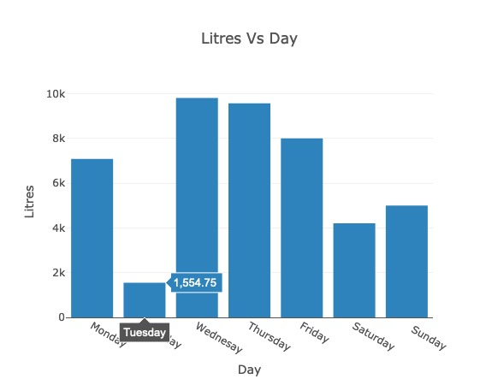
Results from the data we collected

Slide 12
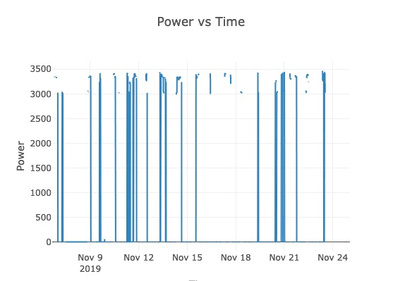
Results from the data we collected

Slide 13
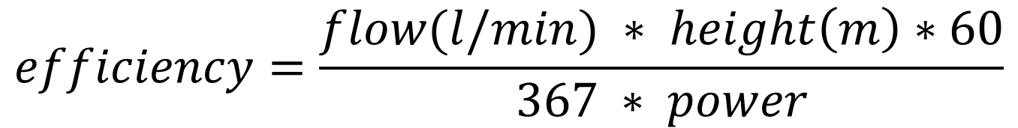
Formula for efficiency
$$efficiency=\frac{flow(l/min) ∗ height\left(m\right)∗60}{367 ∗ power}$$
Putting in the values height = 20, along with the values of flow and power gives us the following graph.

Slide 14
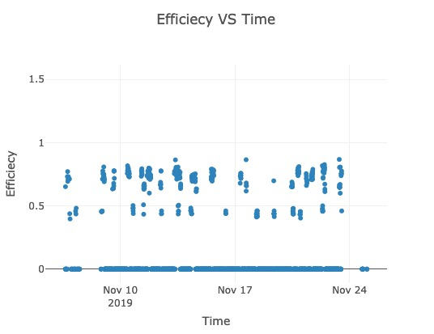
Results from the data we collected

Slide 15
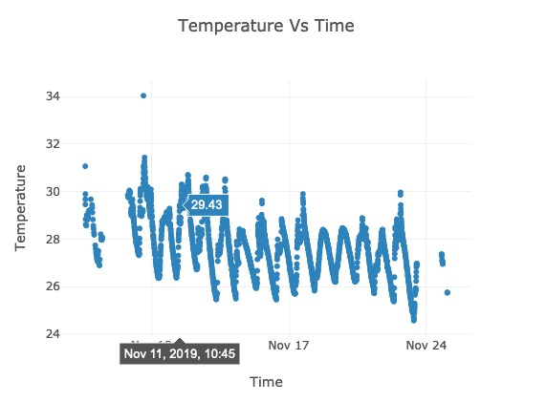
Results from the data we collected

Slide 16
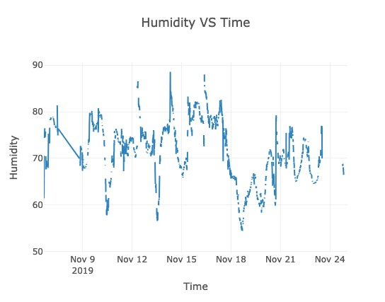
Results from the data we collected

Slide 17
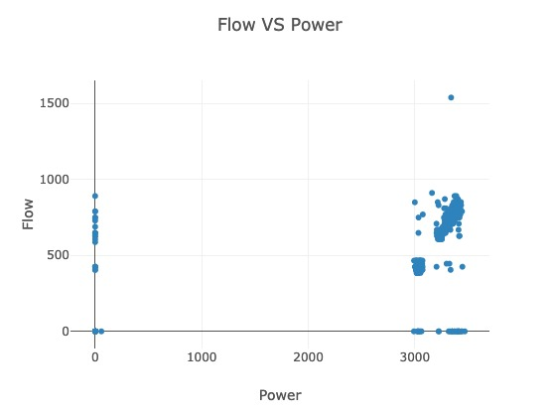
Results from the data we collected

Slide 18
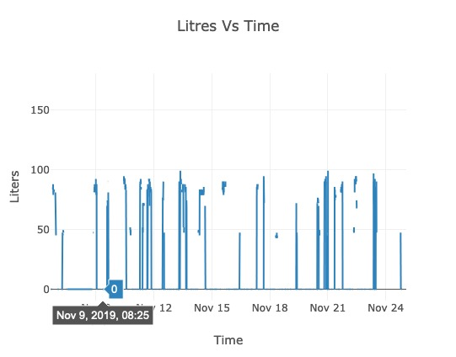
Results from the data we collected

Slide 19
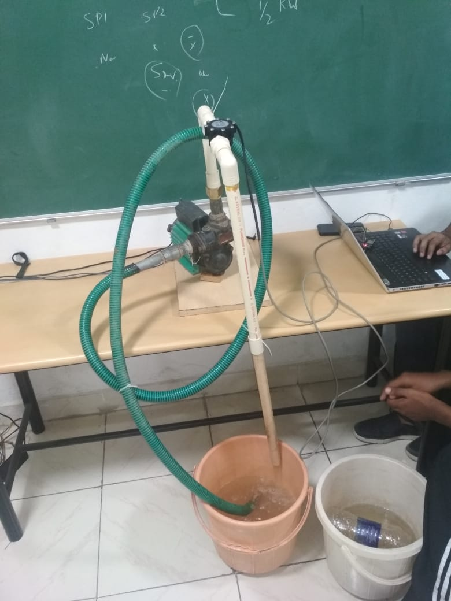
Issues faced
Calibration of flow meter
[we had to stick with the calibration provided
by the manufacturer]

Slide 20
Issues faced
Correctly parsing the registers read using modBus for energy meter [fixed – issue with connections and address values]
Inconsistent output from energy meter [to be figured out]
Temperature sensor got damaged due to voltage given above it’s limit [fixed]
OneM2M server not accessible from inside the IIIT network or outside the network for different wi-fi connections (some ports being blocked or using local IPs) [fixed]

Slide 21
Special Thanks
Dr. Vishal Garg
Prabhakar Sir
SamBabu G Sir

